Slide 1
ElecKartMarket Mix Modeling Mid-Submission
BY:
Nikhil Srivastava
Nandakishore
Ranju
Reena Poddar
Mentor:
Gunjan

Slide 2
Abstract
Business Objective:
Develop a market mix model to observe the actual impact of different marketing variables over the last year.
Recommend the optimal budget allocation for different marketing levers for the next year.
Perform this exercise for three sub-categories: Camera Accessory, Home Audio & Game Accessory
Data Source:
Order level Data for all purchases is available for the period - July 2015 to June 2016
Monthly advertisement spend for the same period
List of holidays for the said period
NPS score is available
Strategy:
Aggregate orders across weeks
Use EDA to identify primary and derived KPIs for effective analysis
Create regression model to arrive at decent market mix model

Slide 3
Derived KPIs
Order Week
Week number of the year in which the order was placed.
List Price
Calculated by dividing GMV with no. of unit sold in the order
Discount %age
Difference between MRP and list price of the product
Premium Products
# of premium products sold as part of total orders in a week
Middle Products
# of middle products sold as part of total orders in a week
Mass Products
# of mass products sold as part of total orders in a week

Slide 4
Derived KPIs (contd.)
%age of Prepaid orders
% of prepaid orders out of total orders in a week
%age of COD orders
% of orders delivered on COD out of total orders in a week
Holiday Frequency
No. of holidays in a week
Lag Variables:
Lag of upto 3 for:
AdStock
Adstock for all advertising medium assuming the effect of advertisement is decreases by 40% every week
Moving Average
3 week moving average for:
List price
Discount %age
List Price
Discount %age

Slide 5
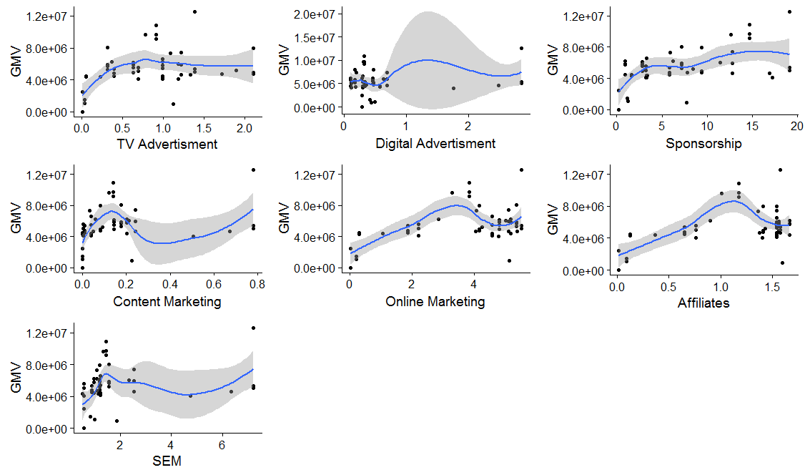
Exploratory Data Analysis – Camera Accessory

Slide 6
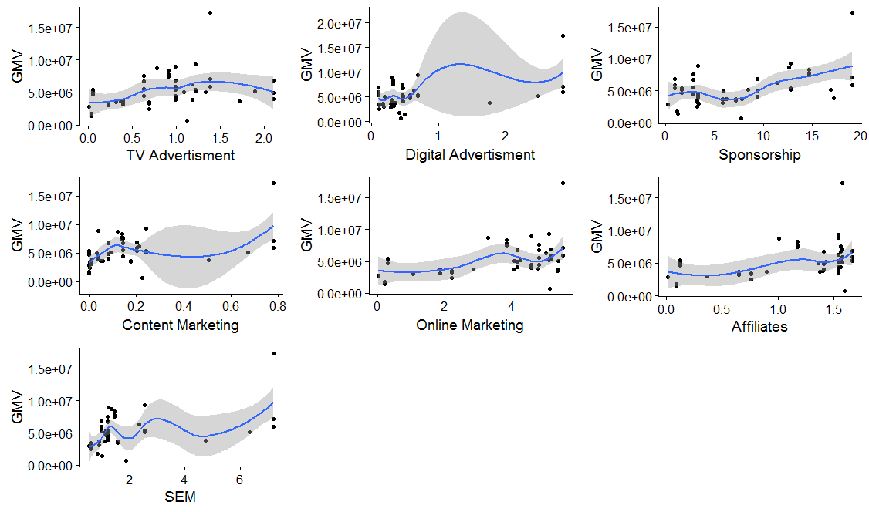
Exploratory Data Analysis – Home Audio

Slide 7
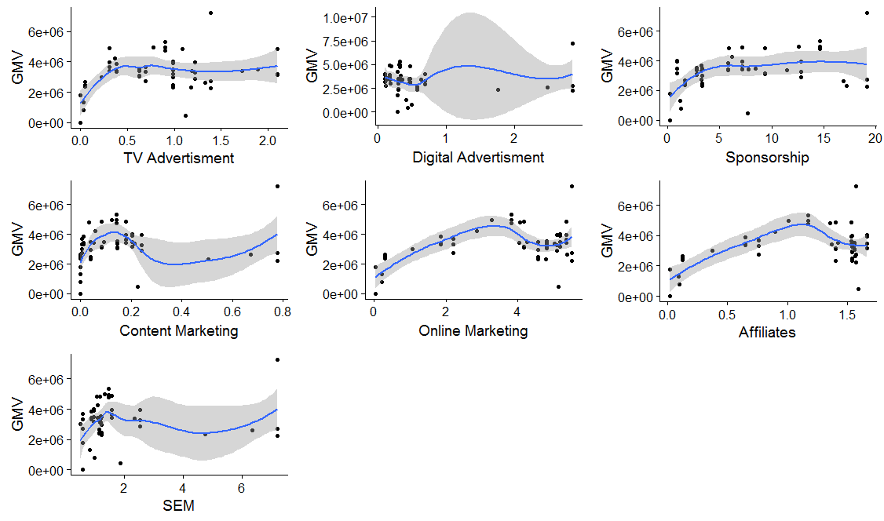
Exploratory Data Analysis – Game Accessory

Slide 8
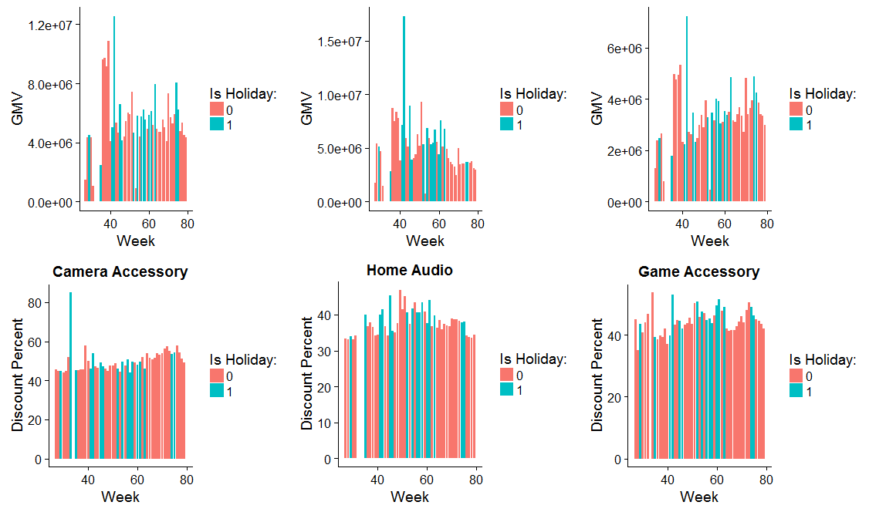
Exploratory Data Analysis – effect of Holidays on Discount & GMV
Sales during holidays were more that the adjoining weeks suggesting a surge in sales during holidays.
Also, discount %age is slightly higher in holidays than normal days to boost the sales

Slide 9

Initial Model – Camera Accessories

Slide 10

Initial Model – Home Audio

Slide 11

Initial Model – Game Accessories

Slide 12


